Slide 1
Welcome to fifth grade in room 4
Please find your desk! ☺
Mr. Isaacs

Slide 2
Get to know a little about me!
Time to think on our feet!

Slide 3
I am the same height as Steph Curry.
False!
TRUE!

Slide 4
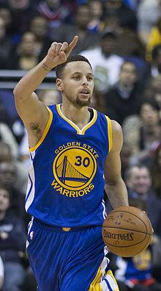
TRUE!

Slide 5
I used to work at disneyland
False!
TRUE!

Slide 6
FALSE!

Slide 7
I play in a band.
False!
TRUE!

Slide 8
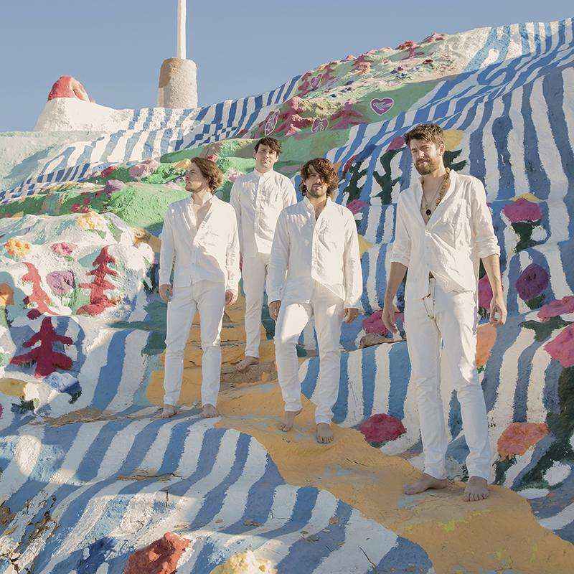
true!

Slide 9
I read every single night.
False!
TRUE!

Slide 10
TRUE!

Slide 11
I scored the most points on my basketball team.
False!
TRUE!

Slide 12
False!

Slide 13
Who is mr. isaacs as a teacher?
I care about: student autonomy, whole child development, quality collaboration, helping kids navigate challenges, and best practices.
I believe: in student centered classrooms, there’s no “one size fits all,” and meaningful work/activities.
I hope: students value their own and others unique worth, leave school every day excited to come back.

Slide 14
In This classroom, we all fit together!

Slide 15
Experience
8 years of teaching
4 years of developing curriculum and teaching at an after-school enrichment program
Masters Degree in Best Educational Practices
Long-term substitute taught 1st and 6th grade at Maloney
Taught 4th and 5th grade at Maloney

Slide 16
Class Schedule
Computer: A days
Science: B days
PE: C days (wear appropriate shoes)
Library: Fridays

Slide 17
Classroom expectations
Here at Maloney we follow 3 basic principles:
Show respect
Make good decisions
Problem solve
If students follow these 3 principles, they will be recognized and rewarded with good citizen awards, extra recess minutes, etc.

Slide 18
Absences
Missed work will be available in the mailbox when the student comes back
Students will have an additional day to finish any work they missed (this rule is flexible depending on each situation)

Slide 19
Typical day
Prep: Computer Lab, Science Lab, PE Language Arts/Reading/Writing Workshops Lunch Math Social Studies/Science Morning recess and afternoon extra PE

Slide 20
Reading/Language Arts
Benchmark/Daily 5/Accelerated Reader
Based on individual levels
Small Group and one-on-one focus
Focused on daily reading and writing at their level with targeted strategy
Whole group discussions and analysis
Independent work

Slide 21
Reading Fluency
Repeated reading increases fluency
Leveled readers increase confidence
“Chunk” and add expression
October – 135 wpm
May – 160 wpm

Slide 22
Math
oMath Expressions
oSpiraled curriculum
oActivity-based program
oCCSS Aligned
oSupplements to build speed in basic facts and operations
⦿Math Masters
oJiji provides non-language based learning and practice while Prodigy provides a fun way to practice standard specific math

Slide 23
Curriculum and programs
Math Expressions
Benchmark: Reading and Writing Workshop
Next Generation Science Standards
Social Studies: United States History, GLAD emphasis, Supplemental Projects, Teamwork and project-based learning
Social/Emotional curriculum
Technology: Chromebooks/Classroom laptops

Slide 24
Workshop at a glance
The Reader’s units of study include:
Building a reading life foundation through fiction texts
Grasping main ideas and text structures through non-fiction texts
Character Studies
Analyzing different genres
The Writer’s units of study include:
Crafting true ‘narrative’ stories
Informational writing through research and reports
Persuasive speeches

Slide 25
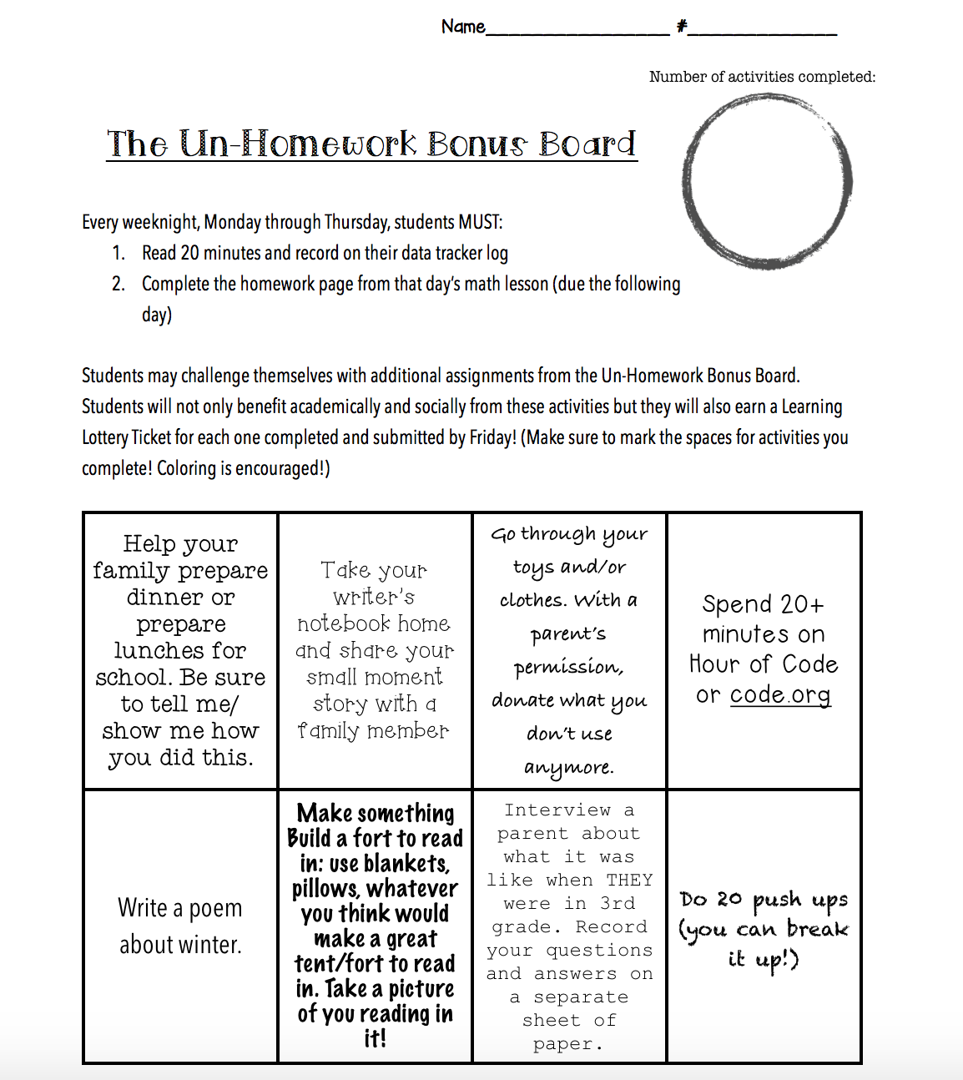
Homework
Nightly Math
30 minutes of reading,
Occasional grammar worksheets
Weekly writing in journals
Un-Homework Bonus Board
-FUSD Homework Policy:
Fremont Homework Policy
No more than 50 minutes of homework per night

Slide 26
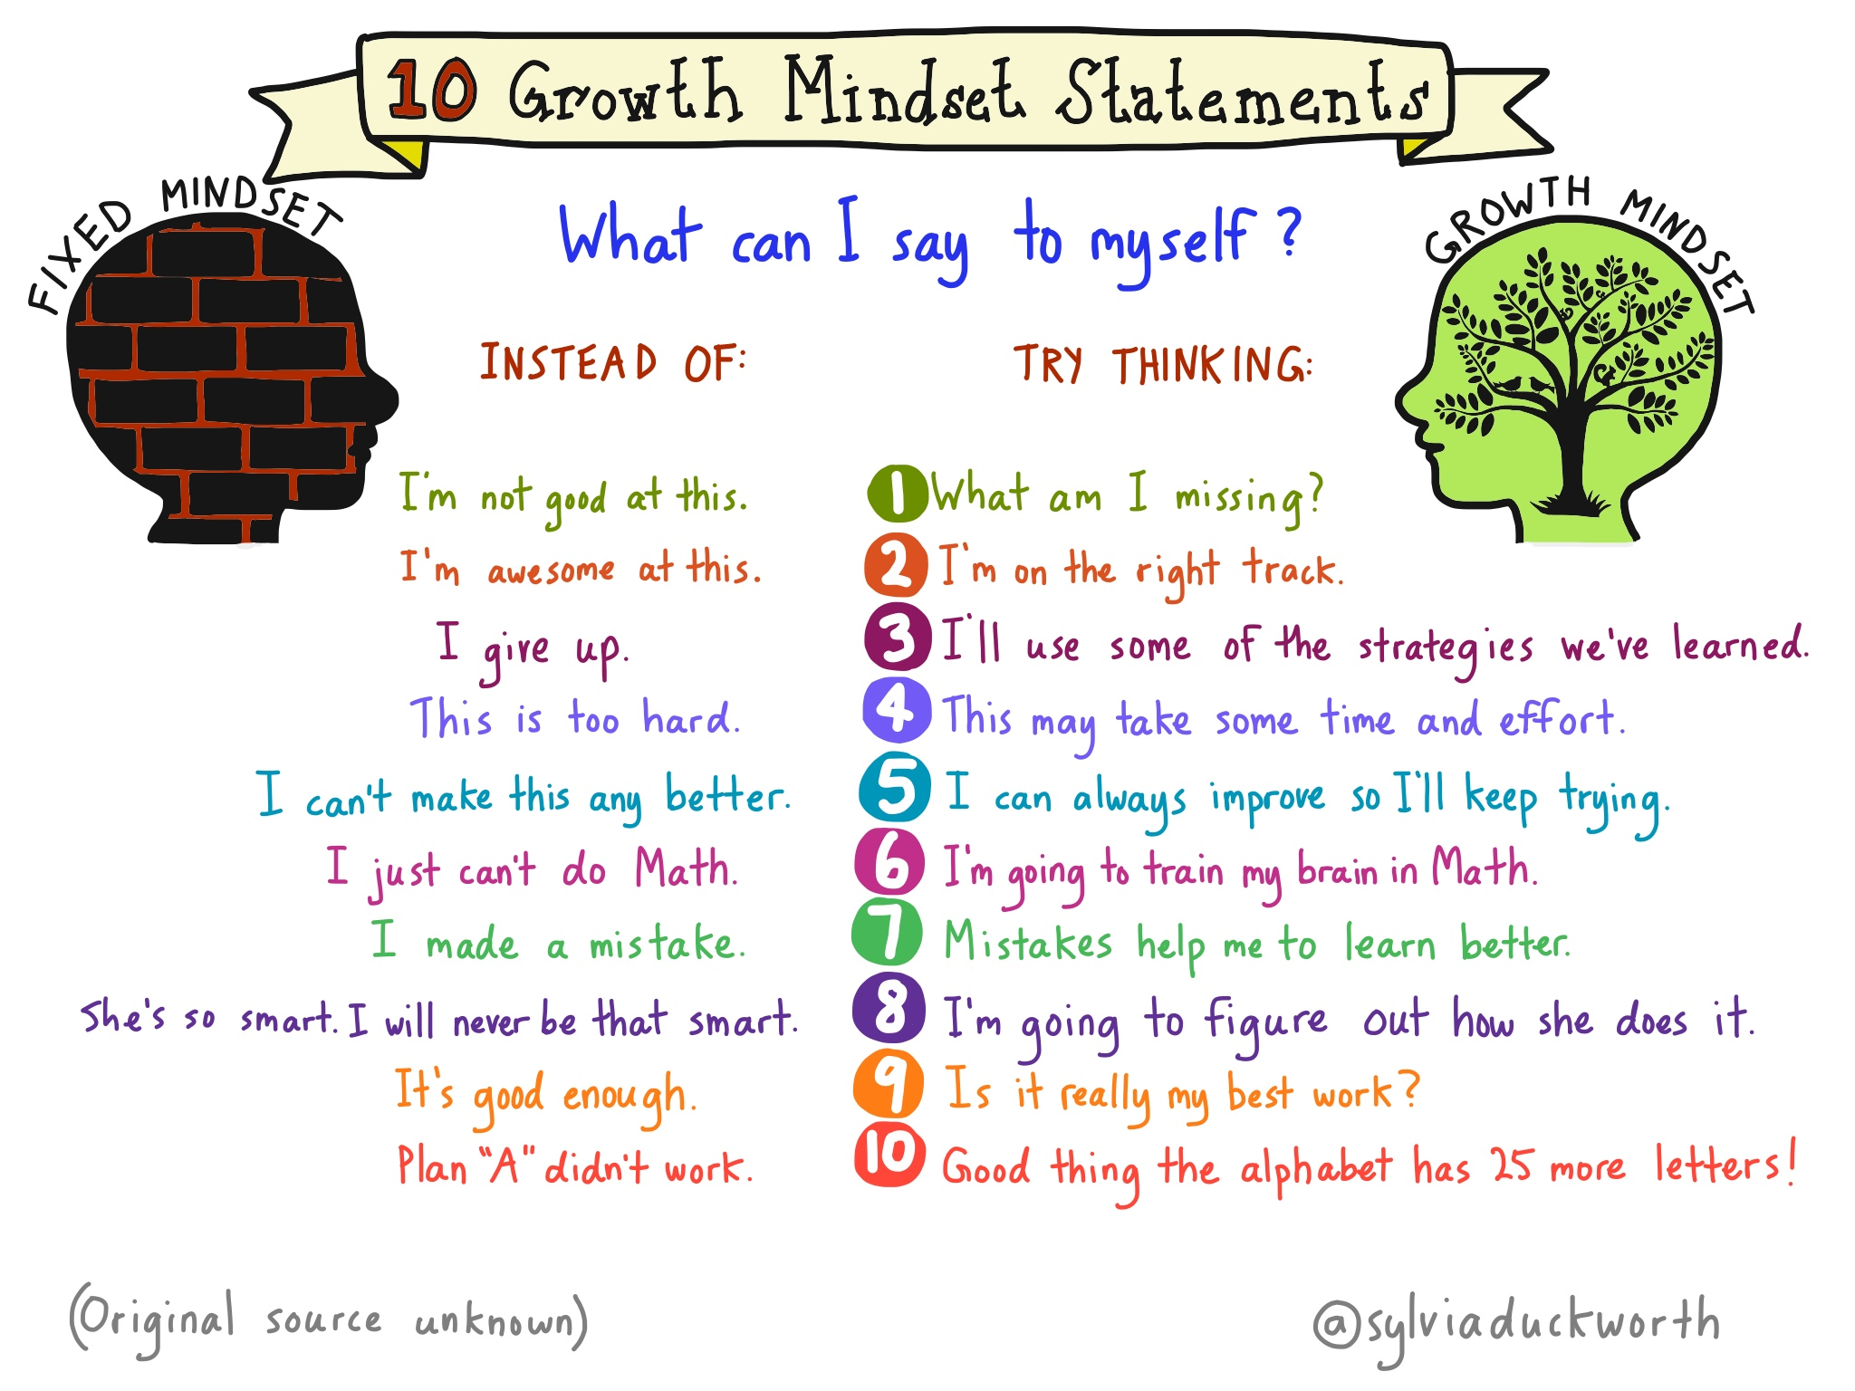
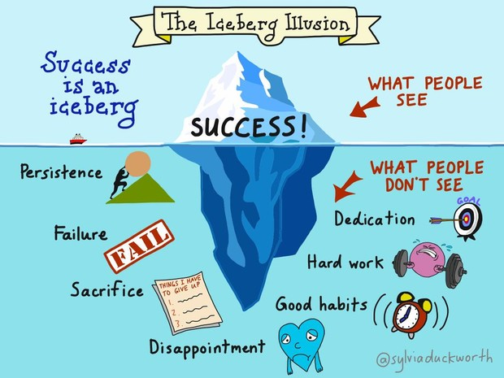
Improvement focus/ Growth Mindset
Student reflection
Whole child development
Teacher/peer feedback

Slide 27
Extra Supplies
Kleenex
Post-its
Copy paper
Binder paper
Hand sanitizer
Glue sticks
Pencils
***Headphones
(Optional)

Slide 28
No food please!

Slide 29
We need Volunteers!
Room Parent(s)
Mystery Readers

Slide 30
Field trips
TBA

Slide 31
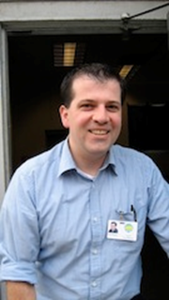
Computers
A days with Mr. Seipert

Slide 32
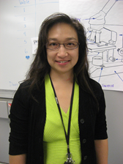
science
Transition to NGSS
Houghton Mifflin- California Science B days with Mrs. Batalao
Study Guide homework assigned by me
Text, lab, projects, and videos with Mrs. Batalao

Slide 33
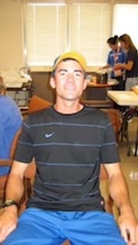
P.E.
C days with Mr. Sardello
Need to wear appropriate clothing - Sneakers - Layers

Slide 34
PTA
Donations to join: Meetings not required
Sign up sheets in back of classroom

Slide 35
Parents + teachers = TEAM

Slide 36
Mystery readers
Calling all parents, grandparents, siblings, neighbors!
Surprise your student by bringing in and reading a favorite picture book
Everything MUST be kept TOP SECRET
Five clues about yourself
Sign up for Fridays

Slide 37
A Letter to your child

Slide 38
communication/ Contact Information
Email: cisaacs@fremont.k12.ca.us
Website: Mr. Isaacs Site

Slide 39
Thank you for attending! I appreciate your partnership in your child’s educational journey. We have an exciting year ahead of us!

